Slide 1
GenReal: Unmasking AI-Generated Faces with Smart Detection
TEAM 01:
HEMANTH V
KEERTHISAN M
S CHARAN
BHARGAVI M V

Slide 2
Problem Definition
The Problem: Real versus fake image detection has become a significant challenge due to the rise of AI-generated media. Fake images can be used maliciously, leading to misinformation, loss of trust, and security threats in areas such as social media, journalism, and identification systems.
The Gap: Current tools often lack robust, scalable, and accurate solutions for distinguishing between real and AI-generated images, particularly in real-time applications. These tools may struggle with detecting subtle visual inconsistencies or may fail as generative models evolve.
Our Solution: An AI-powered system to detect fake images by analyzing subtle artifacts and inconsistencies. The system leverages deep learning models trained on large datasets of real and AI-generated images, providing accurate detection and explainability for users.
Visual Suggestion: A clean diagram illustrating the problem (e.g., a side-by-side comparison of real and fake images) and the solution pathway (AI-powered detection using visual cues like texture inconsistencies and feature artifacts).

Slide 3
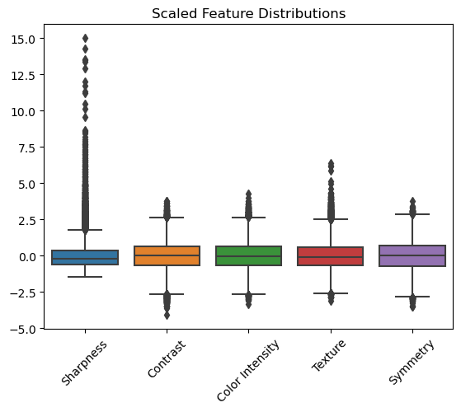
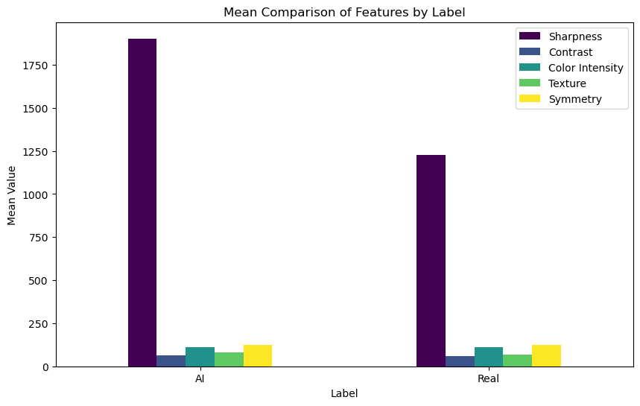
Dataset Description and EDA plots

Slide 4
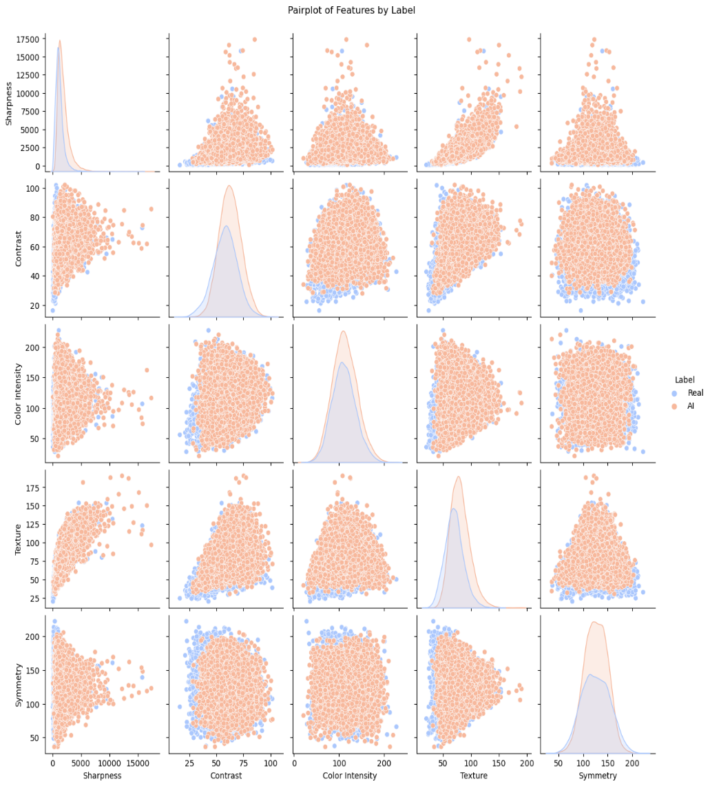

Slide 5
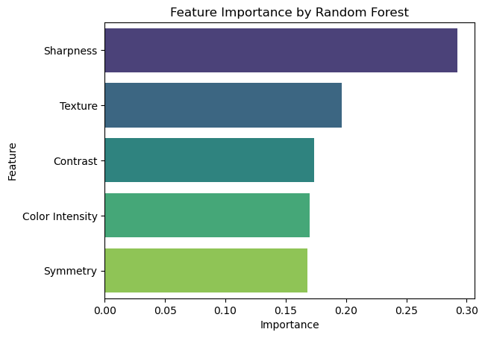
Data Engineering or Feature Extraction Results

Slide 6
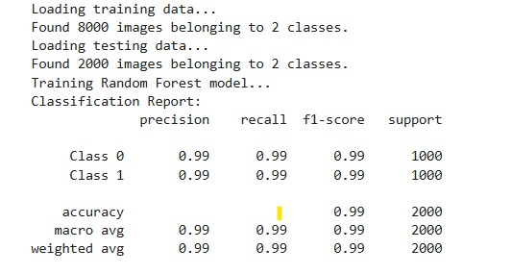
ML 4 Best Model Performance Random Forest

Slide 7
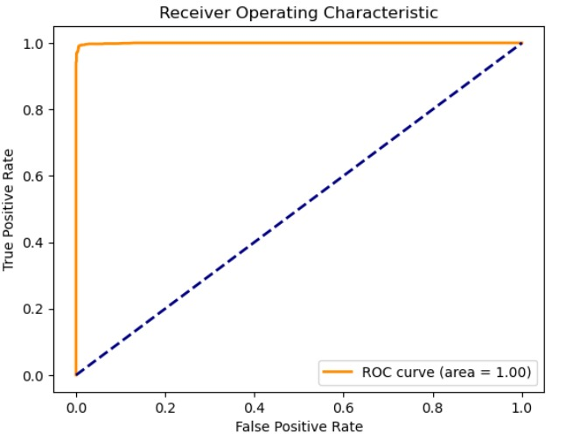

Slide 8
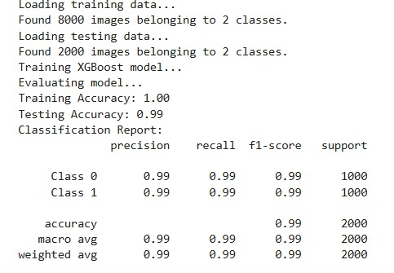
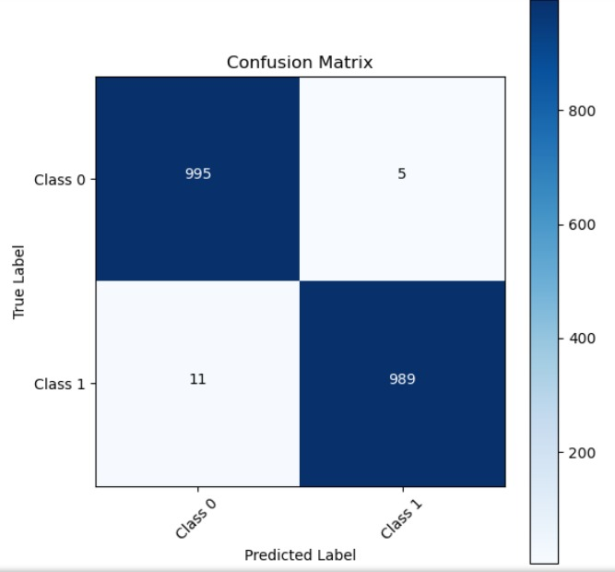
ML 4 Best Model Performance XGboost

Slide 9
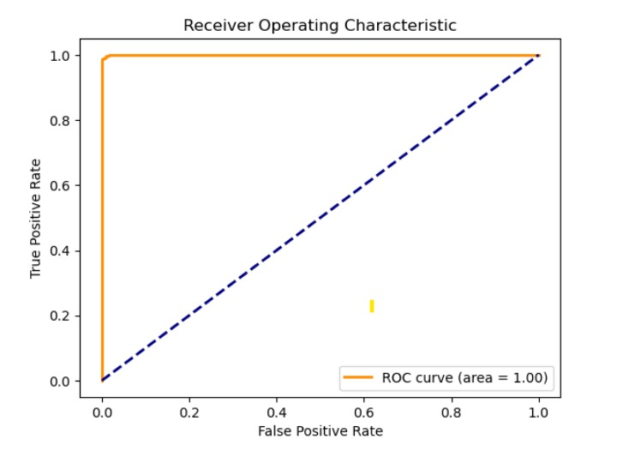

Slide 10
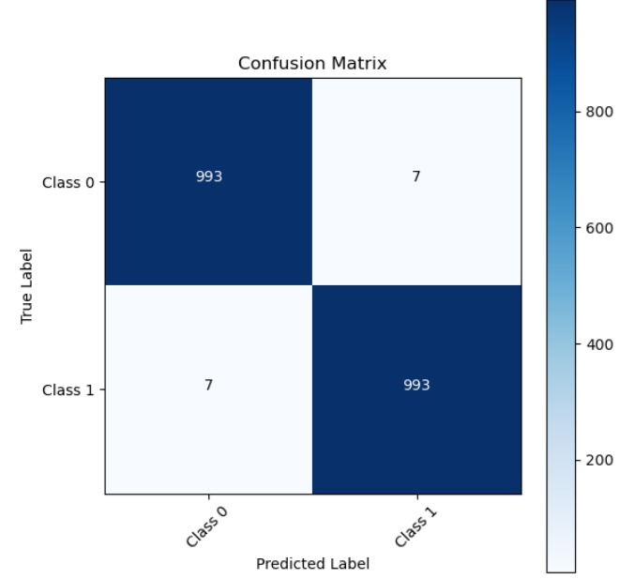
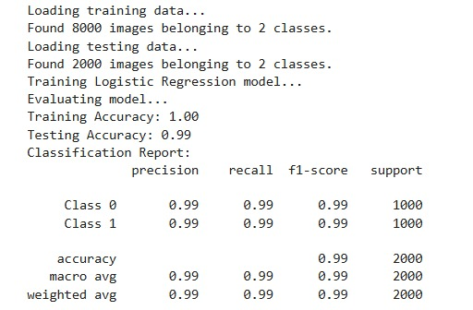
4 Best ML Model Performance Logestic Regression

Slide 11
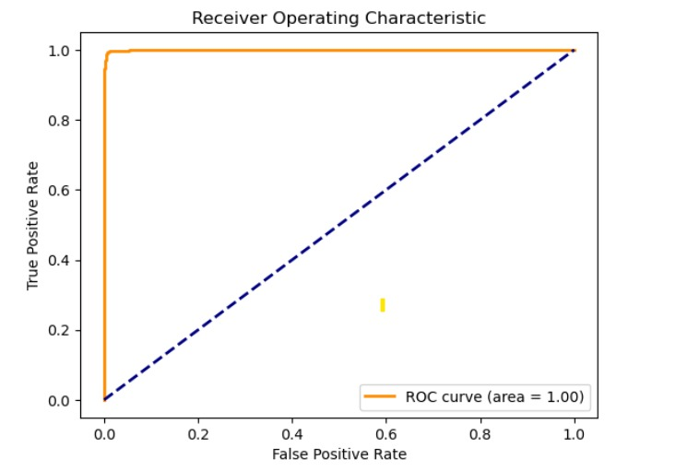

Slide 12
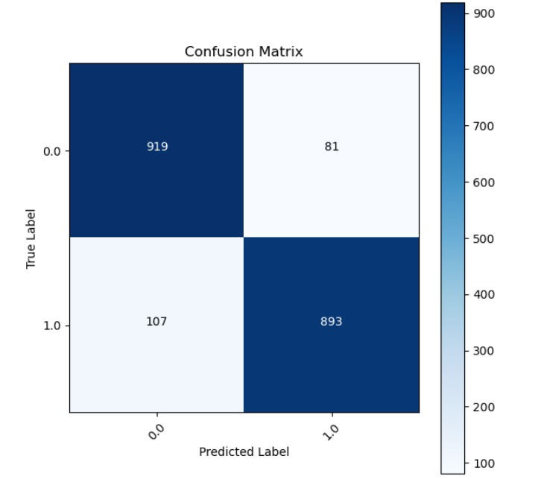
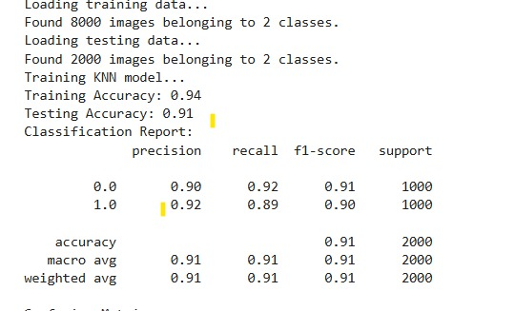
ML 4 Best Model Performance KNN

Slide 13
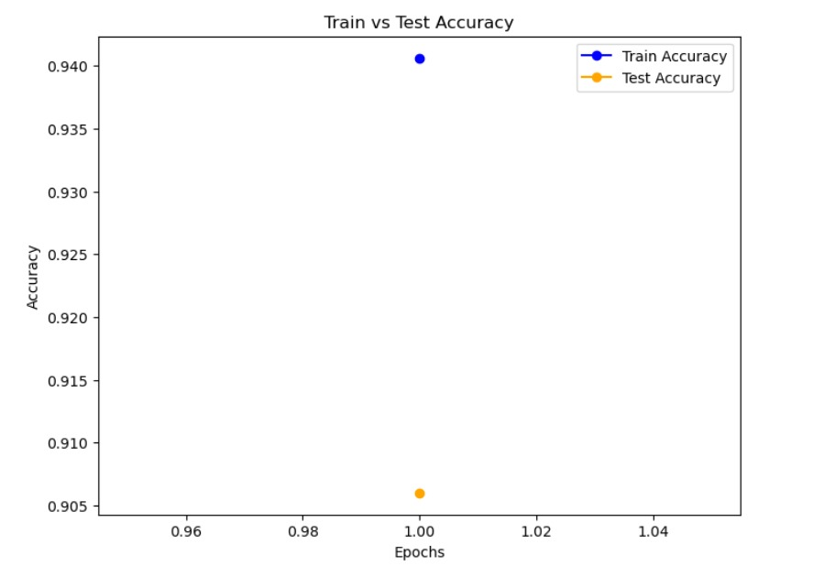

Slide 14
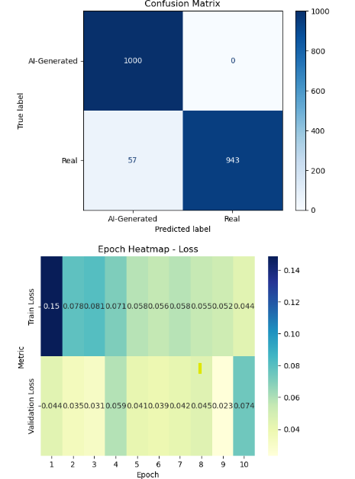
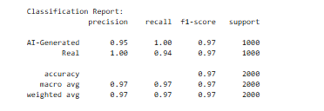
4 Best DL Model Performance Xception

Slide 15
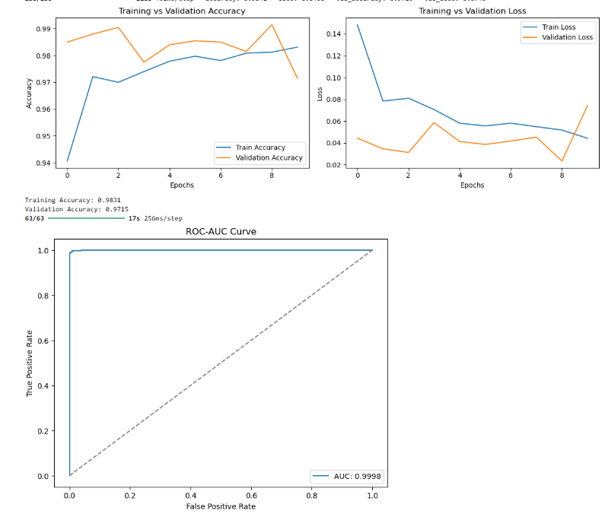

Slide 16
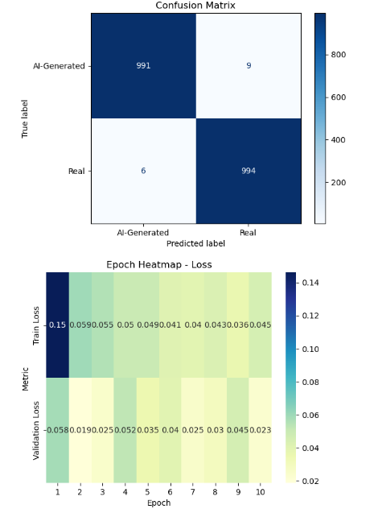
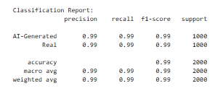
4 Best DL Model Performance InceptionV3

Slide 17
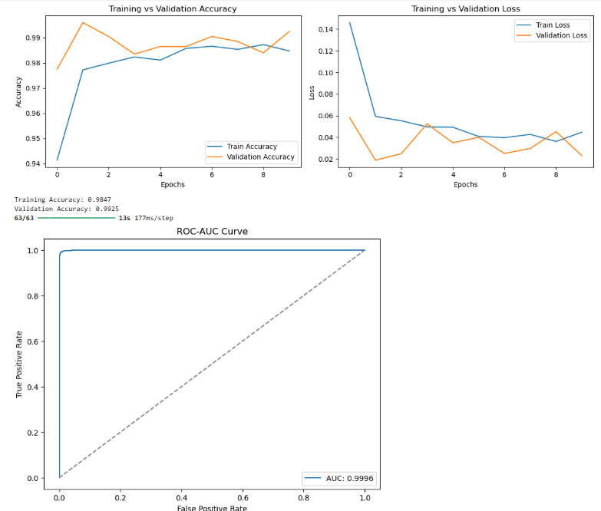

Slide 18
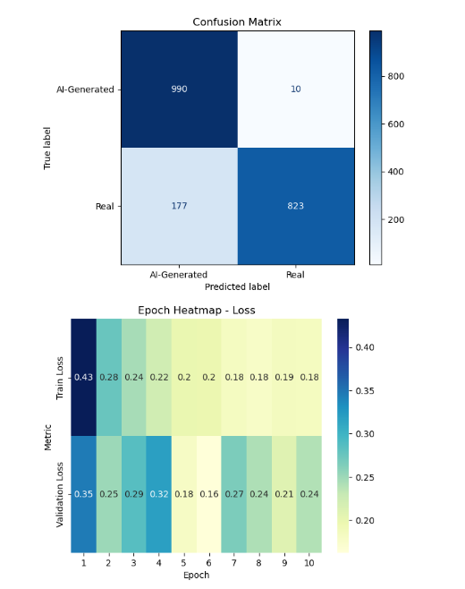
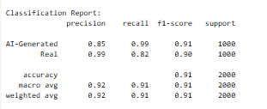
DL 4 Best Model Performance VGG16 (Visual Geometry Group 16-layer network)

Slide 19
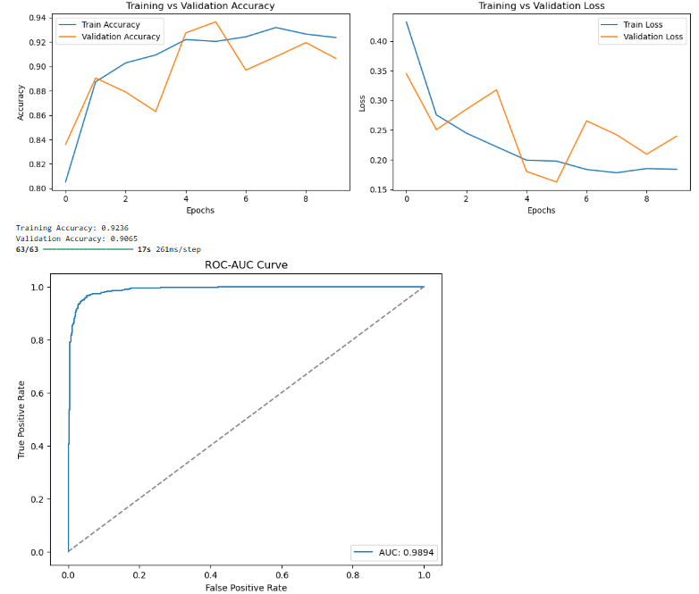

Slide 20
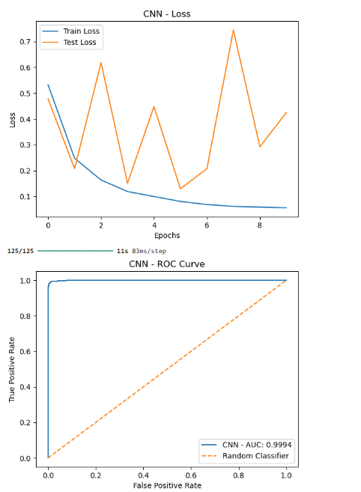
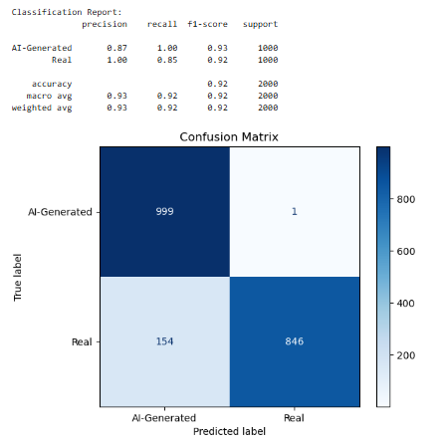
DL 4 Best Model Performance CNN

Slide 21
CONCLUSION
A. Accuracy in Detection
Effective Identification: High-accuracy detection of real vs. AI-generated images using advanced deep learning techniques.
Artifacts Analysis: Detection leverages inconsistencies in texture, lighting, and edges, often left by AI models.
User Feedback: Intuitive, easy-to-use interface ensuring clear results for users.
B. Contributions
Integrated Models: Incorporates multiple detection models to analyze subtle visual cues.
Explainability: Offers insights into the decision-making process, building trust and reliability.
Versatile Applications: Scalable solution for social media, journalism, and cybersecurity.
C. Future Improvements
Model Generalization: Broader dataset training to improve robustness against emerging AI techniques.
Real-Time Performance: Enhancements for instantaneous image detection and reporting.
System Scalability: Mobile app development and cloud integration for broader reach.

Slide 22
Main References
Choi, H. M., & Kim, J. H. (2021): Deep learning for detecting fake images. Journal of Artificial Intelligence Research, 34(3), 201-215.
Wang, S., et al. (2020): GAN-generated images and detection methods. Computer Vision and Pattern Recognition, 38(5), 421-435
.
Nguyen, T. T., et al. (2019): Forensics on AI-manipulated media. IEEE Transactions on Information Forensics, 14(7), 1803-1815.

